Slide 1
VISUAL C#.NET session 16
Instructor: Edwin oduor

Slide 2
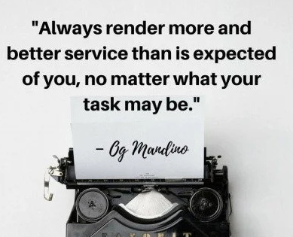
Quote of the day

Slide 3
Lesson objectives
Introduction to Structured Query Language (SQL)
Installing SQL Server
Creating a Database
Creating a Table
Deleting a Database
Deleting a table
Inserting Records in a table
Writing Queries

Slide 4
Lesson pre-requisites
In order to take full advantage of this section you need to have the following;
Computer with Visual Studio Installed.
Stable Network Connection.

Slide 5
Training methods and extra readings
TRAINING METHODS FOR THIS LESSON
EXTRA READINGS
Lecturing Method – This is the main method of training to be adopted in this lesson with illustrations and practical coding examples.
Discussion Method - This method will be adopted periodically whereby learning will be derived principally from the students brainstorming together, rather than from the trainer. Three main types of discussions will be used:
Directed discussion
Developmental discussion
Problem-Solving discussion
Home and Learn C#

Slide 6
STRUCTURED QUERY LANGUAGE(SQL)

Slide 7
WHAT IS SQL

Slide 8
SQL is a language that is used to query data in a relational database.
SQL is a language that is understood by the database, so if one wants to communicate with the database i.e. storing records, retrieving records, deleting and updating records then one will have to write SQL query for this to happen.

Slide 9
INSTALLING SQL SERVER
To install SQL Server first one needs to know the operating system that is installed in your machine i.e. if it 32 or 64 Bit, after knowing this, visit Microsoft website to download SQL Server Studio and install it after downloading.
Double click on the downloaded file. Upon opening one will get the following window.

Slide 10
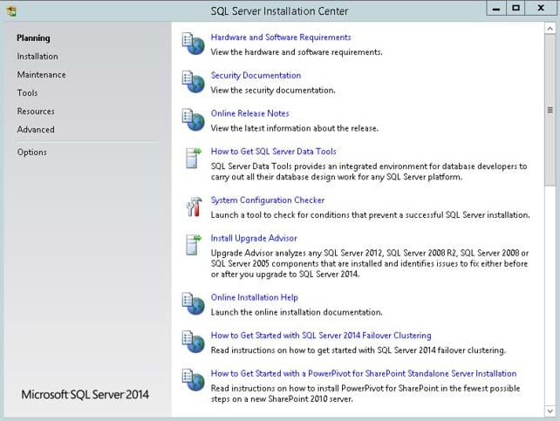
INSTALLING SQL SERVER
Click on Installation

Slide 11
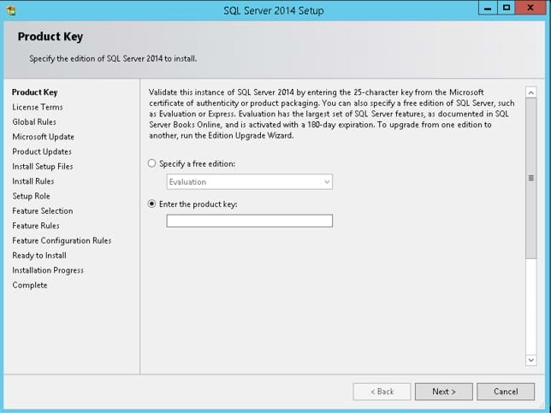
INSTALLING SQL SERVER
Enter the product key.

Slide 12
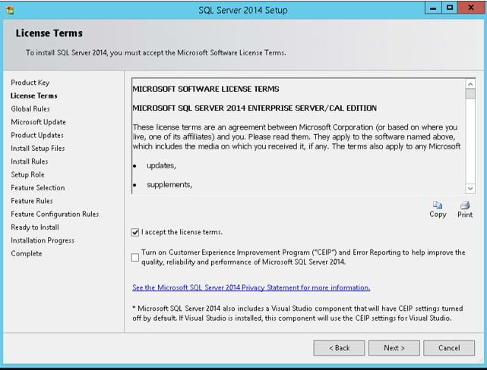
INSTALLING SQL SERVER

Slide 13
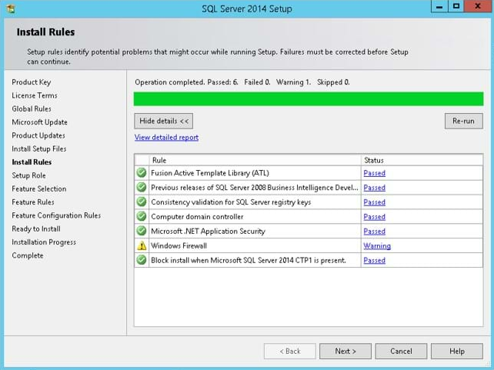
INSTALLING SQL SERVER
Ensure that all is well, i.e. no errors then click next

Slide 14
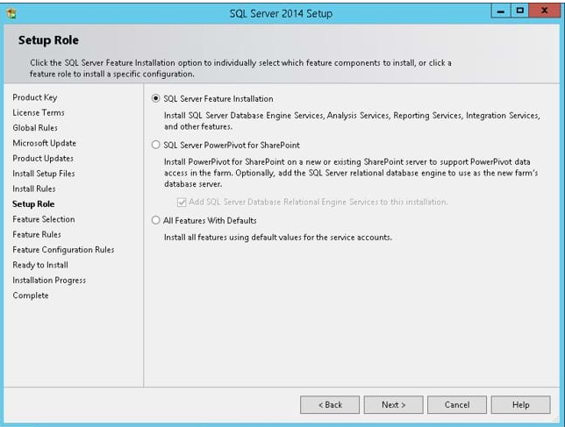
INSTALLING SQL SERVER

Slide 15
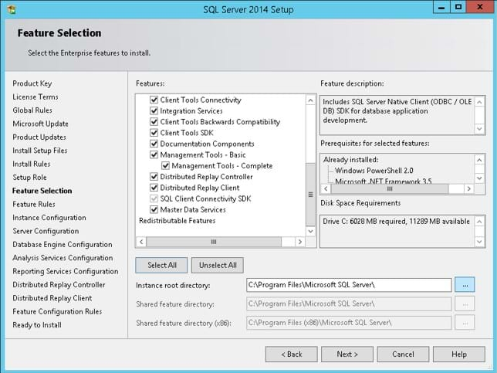
INSTALLING SQL SERVER
Choose the features to be installed.

Slide 16
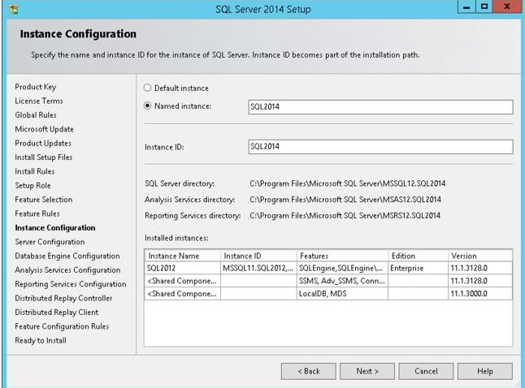
INSTALLING SQL SERVER
Click Next

Slide 17
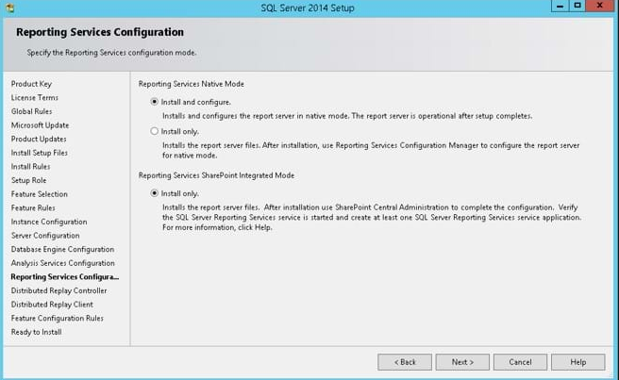
INSTALLING SQL SERVER
Click Next

Slide 18
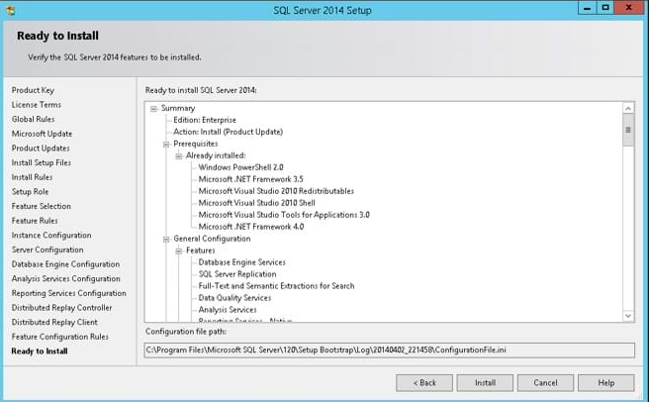
INSTALLING SQL SERVER
Click Next

Slide 19
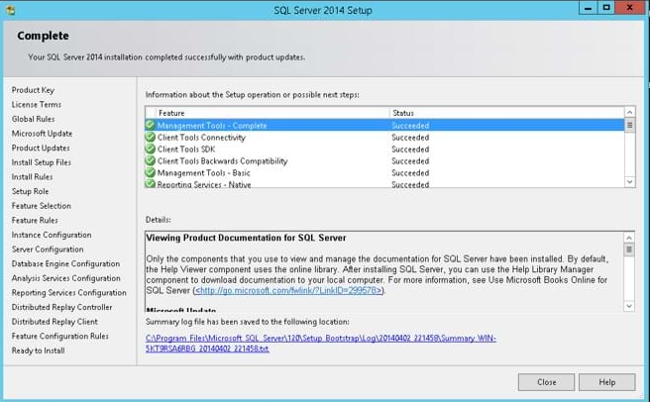
INSTALLING SQL SERVER
Once clicked next, up to completion. The following window will be displayed, showing that the installation was a success.

Slide 20
Once we have already installed SQL Server studio and we know that SQL is a language that the database understands. Let’s proceed and create the database.
To create a database, click on new query, then use the create keyword followed by the name of the database. In our case we want to create a database by the name pharmacyDB

Slide 21
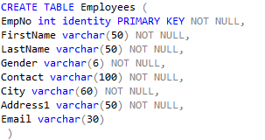
Creating a database & table
In our above code a table by the name Employees has been created, the table has eight fields, EmpNo, the data type is integer, identity means that the value is going to increase automatically, Primary Key this means that this field is not going to allow duplicates. Not null the field should not be empty. The other field is FirstName the datatype is var char and its’s going to hold 50 characters, the rest applies to all the other fields the number of characters is the only thing that is different for the fields.

Slide 22

Deleting a Database
Deleting a Table
Inserting Records in a table

